Slide 1


R-IBES: “Reverse-Image Biographical Entity Search”
Jacob Weber
Generated by Stable Diffusion

Slide 2
What is R-IBES?
The first reverse-image biographical search engine
Uses advanced facial recognition algorithms locally and in the cloud to match faces in ~0.684 seconds
The search engine gets smarter each time it’s used by saving new faces to its database
Takes advantage of a JSON-ified Wikipedia clone called “DBpedia” to handle biographical search queries for the identified person

Slide 3



How does R-IBES work?
Notes:
1500 lines of Python
2 SQLlite tables
AWS Rekognition using a lightweight S3 bucket

Slide 4


Slide 5
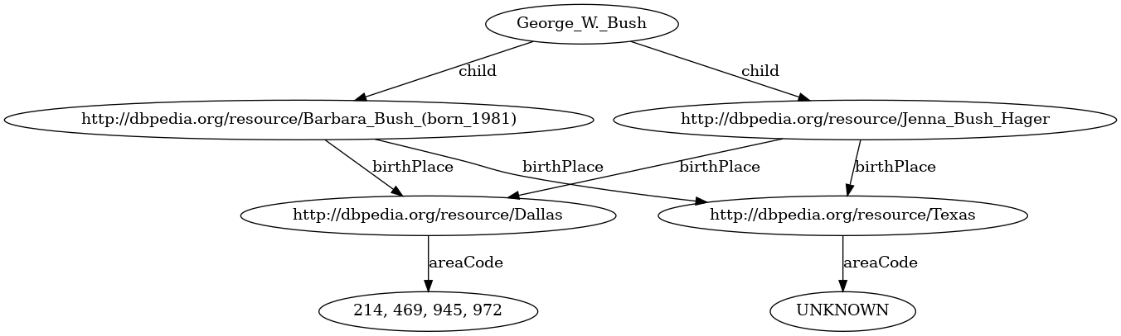

Slide 6




Jacob Weber
Name and query are combined and searched!
Search Locally
Match Found
User contributes name
Search AWS
Match Found
Not Found
Not Found
User declines to contribute

Slide 7
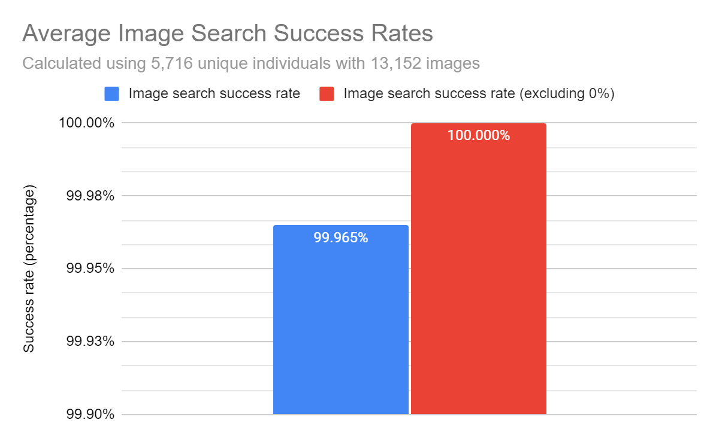
How does R-IBES perform?
Average time per image match: 0.684 seconds
Standard deviation: 0.079 seconds
Notes:
11% stddev time

Slide 8
Possible next steps…
Generalize the algorithm to support object recognition and multiple faces
Support for natural language queries
Possibly use a LLM to match NL to DBpedia tags?
More efficient encoding lookups through optimized hashed data structures
Automate Sphinx documentation website refreshes and successfully host a GitHub Pages site for it
Optimize the project for external use and contributions without a provided DB file
Run computations on a remote server rather than a client machine allowing for more complex and intensive workloads

